Slide 1



STOCK ANALYSIS AND PORTFOLIO MANAGEMENT
Capstone Project
THE TEAM
Naresh Kumar
Neil
Pooja Kumari

Slide 2
OBJECTIVE
To analyze the performance of 12 stocks and creating a portfolio of stocks based on the client’s requirements.
Identifying trends in relevant dimensions- in this case the Close price and volume traded are considered.
Determining how these trends can be applied for the creation of portfolio.
Suggestive investment strategy for the client.
Predicting the future price of the stocks in the chosen portfolio.

Slide 3
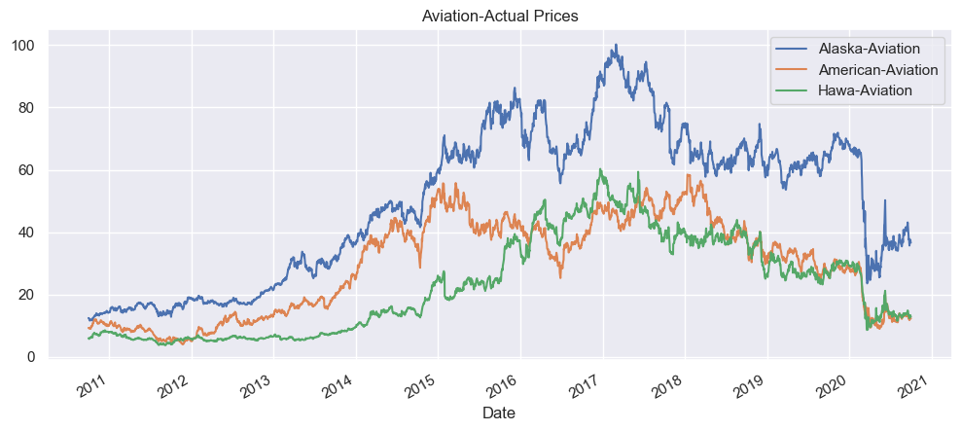
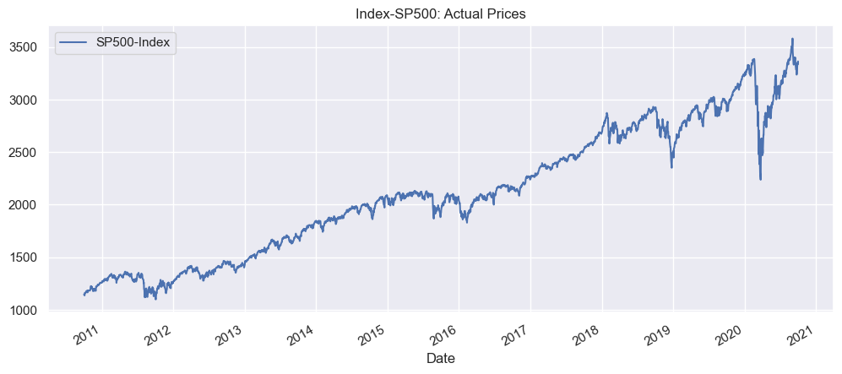
Price Trend-Actual Prices
Aviation Sector:
All the three stocks in the aviation sector had an increasing trend until 2017-18.
From 2017-18 there are ups and downs until March 2020.
In March 2020, the steep fall in prices could be noticed.
This may be attributed to the Covid outbreak by which the top and bottom lines of all the companies in aviation industry invariably were hit badly.
After March, there exists a small but positive trend in the prices of all the stocks.
The stocks behave in sink with the index SP500 from March 2020 onwards.

Slide 4
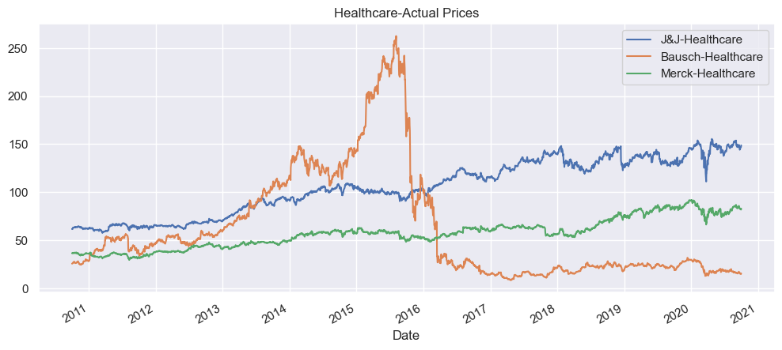
Price Trend-Actual Prices
Healthcare sector:
Bausch started low, reached its peak in mid 2015 followed by a very steep fall through 2016. The charges of inappropriate accounting led Bausch to suffer this fall. Bausch also has a huge debt burden, which compounded the problem.
Johnson & Johnson and Merck grow steadily.
Johnson & Johnson is found to be one of the companies that recovered swiftly after the Covid outbreak followed by Merck while Bausch is yet to recover.

Slide 5
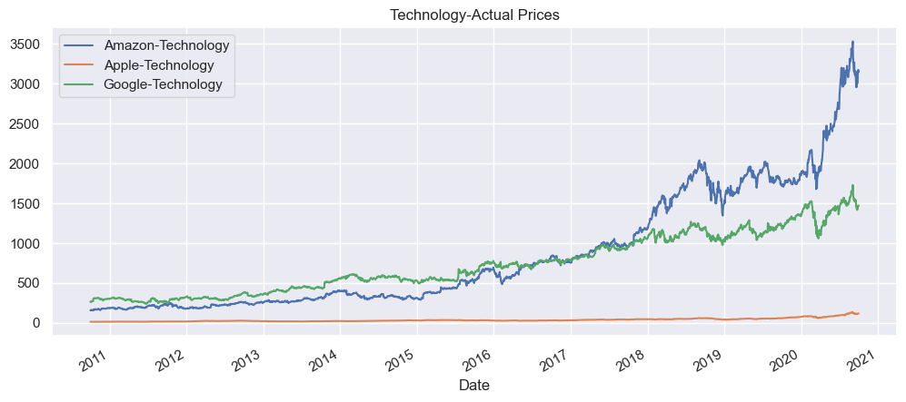
Price Trend-Actual Prices
Technology sector:
All the three stocks show a clear uptrend, Amazon being the mostly sough after.
The growth of Amazon is phenomenal while Apple is progressing steadily.
Google was at the top in the beginning of the period but from 2018 onwards the prices have fallen below Amazon.
Price levels among these stocks vary widely. Apple’s prices are the lowest and hence traded more than Google

Slide 6
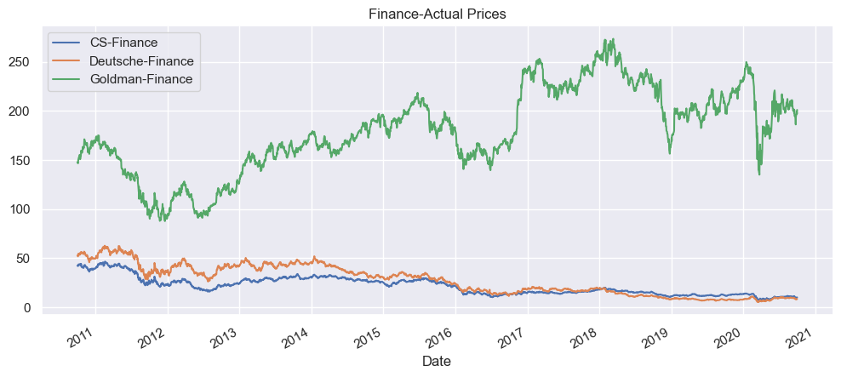
Price Trend-Actual Prices
Finance sector:
In March 2020, the steep fall in prices could be noticed.
Significant variation in price level between Goldman Sachs and the other two stocks.
This may be attributed to the Covid outbreak by which the top and bottom lines of all the companies in aviation industry invariably were hit badly.
Credit Suisse and Deutsche Bank show a clear negative trend while the Goldman is bumpy but overall positive.
After March, the recovery of Goldman is in line with the index but hasn’t yet reached the pre-covid levels.

Slide 7
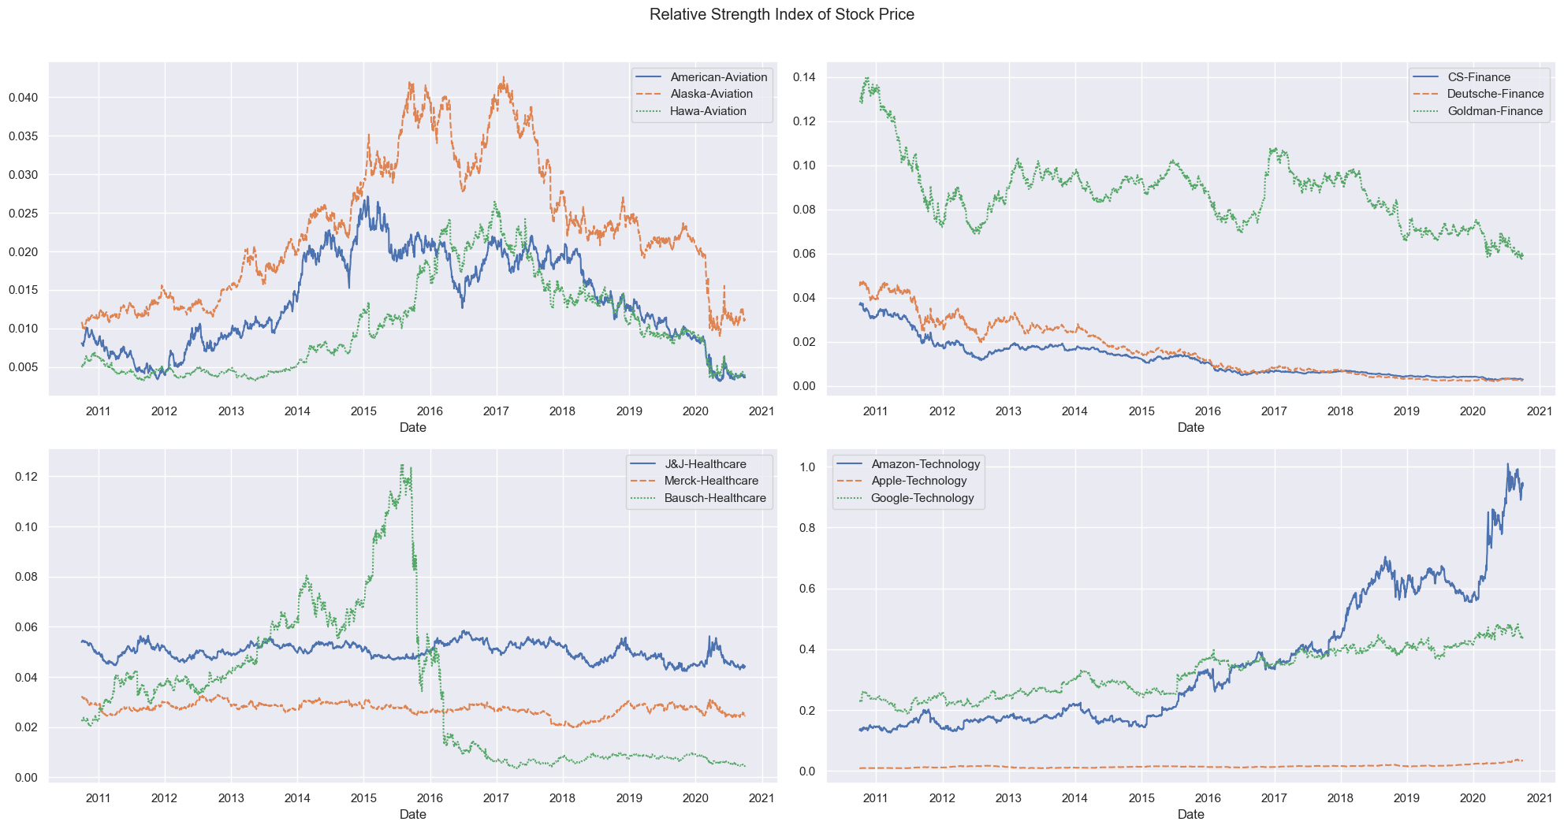
Relative Strength index of Stock prices
Significant variation in price level between Goldman Sachs and the other two stocks.
Credit Suisse and Deutsche Bank show a clear negative trend while the Goldman is bumpy but overall positive.
In March 2020, the steep fall in prices could be noticed.
After March, the recovery of Goldman is in line with the index but hasn’t yet reached the pre-covid levels.
Amazon and Google show a clear positive trend while the Apple is bumpy but overall positive.

Slide 8
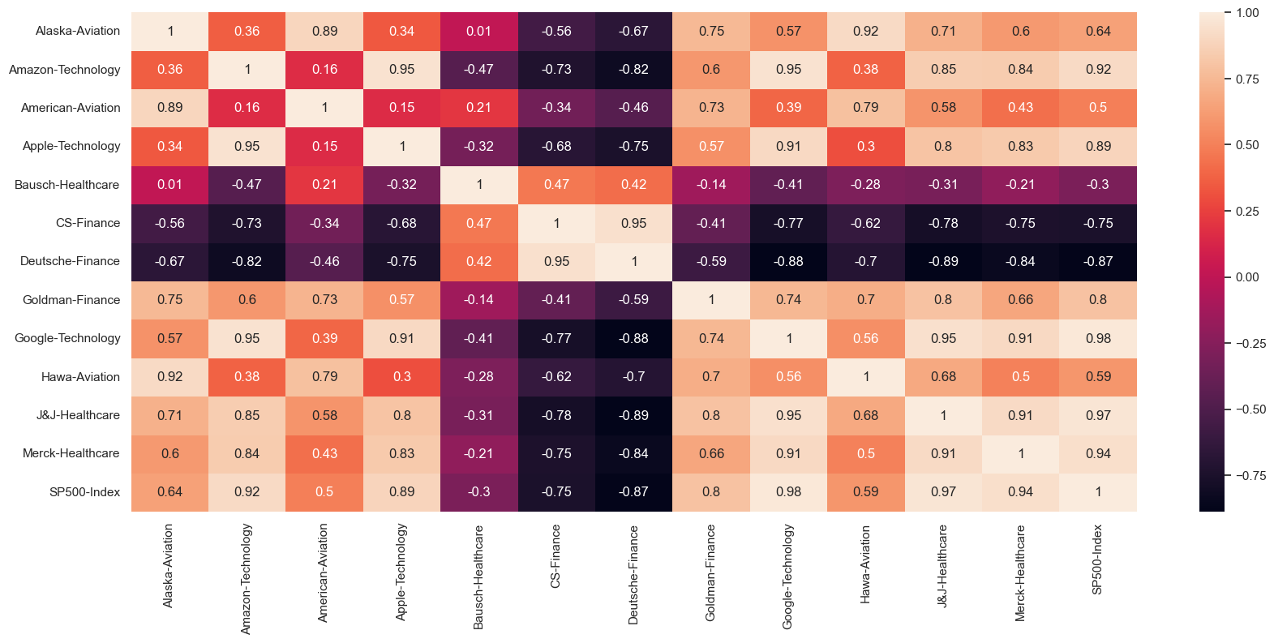
CORRELATION OF PRICE OF STOCKS
Stocks with Strong Positive Correlation (0.6 to 1): Apple, Amazon, Google, Goldman Sachs, J&J, Merck & Co & Alaska.
Stocks with Negative Correlation (0 to -1): Bausch Health, Credit Suisse, Deutsche Bank.
Stocks with Weak Positive Correlation (0 to 0.6): American Airlines, Hawaiian Holdings.
Ideally, the stocks that have negative correlation with the Index (S&P 500) should be avoided in the portfolio since they may prove to be very risky.

Slide 9
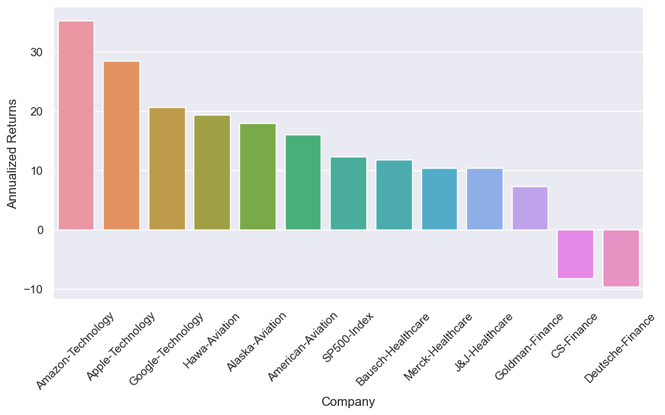
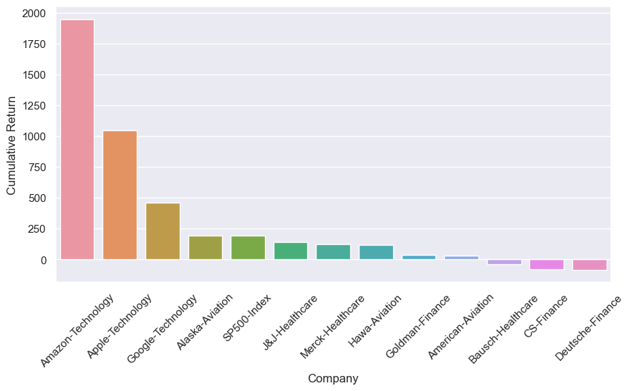
CAPM-METRICS USED FOR SELECTION OF STOCKS
Comparing Annualized & Cumulative Returns we will get that the highest returns have been from Amazon followed by Apple and then Google.
Both have two common stocks in negative CS-Finance & Deutsche-Finance.
Alaska- Aviation stocks performed better next to tech companies, positive and above the SP500 index
To meet the investment goals of the client, we will not include any stocks giving negative returns in the portfolio.

Slide 10
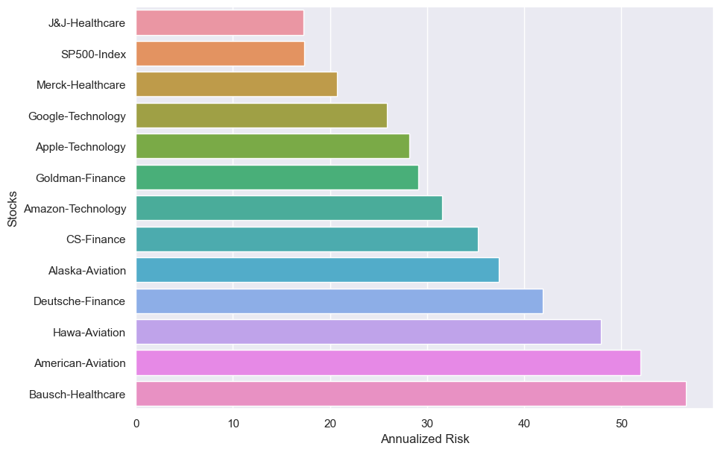
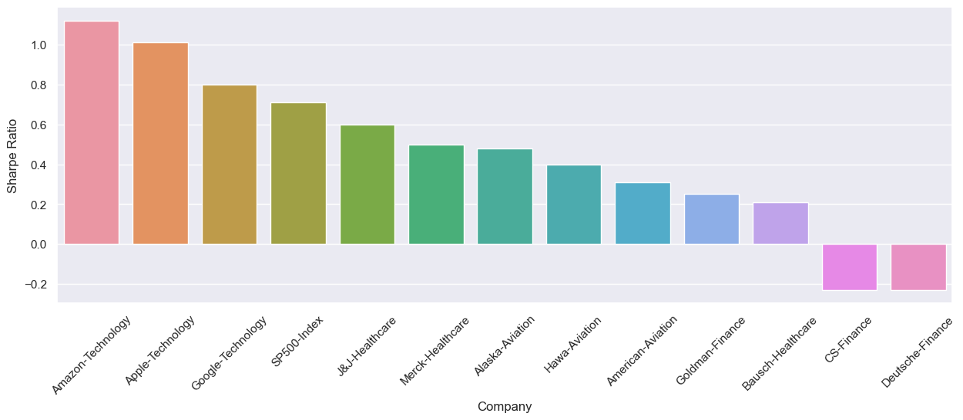
CAPM-METRICS USED FOR SELECTION OF STOCKS
Bausch is the riskiest among all the stocks in other industry as well while Johnson &Johnson is the least annualized risk and the only stock which is less riskier than the index among all.
In Finance industry, all stocks are riskier than the index.
Credit Suisse and Deutsche Bank show negative sharp ratio so its better to avoid these stocks.
All the three stocks in Technology industry stocks have moderate risk.

Slide 11
CAPM RESULTS
S. No | Stocks Name | Annualized Returns | Cumulative Returns | Annualized Risk | Sharp Ratio | Beta | Expected Returns
1. | Technology-Amazon | 35.22 | 1948.49 | 31.57 | 1.12 | 1.00 | 12.28
2. | Technology-Apple | 28.4 | 1047.77 | 28.13 | 1.01 | 1.06 | 13.02
3. | Technology-Google | 20.6 | 461.28 | 25.86 | 0.8 | 1.01 | 12.44
4. | Aviation-Alaska | 17.87 | 194.28 | 37.4 | 0.48 | 1.23 | 14.96
5. | Aviation-American | 16.03 | 32.29 | 51.95 | 0.31 | 1.35 | 16.37
6. | Aviation-Hawa | 19.29 | 116.28 | 47.86 | 0.4 | 1.23 | 14.99
7. | Healthcare-J&J | 10.3 | 141.1 | 17.22 | 0.6 | 0.66 | 8.39
8. | Healthcare-Merck | 10.34 | 126.64 | 20.72 | 0.5 | 0.73 | 9.21
9. | Healthcare-Bausch | 11.71 | -39.65 | 56.67 | 0.21 | 1.32 | 15.94
10. | Finance-CS | -8.19 | -76.39 | 35.25 | -0.23 | 1.37 | 16.56
11. | Finance-Deutsche | -9.62 | -84.03 | 41.87 | -0.23 | 1.54 | 18.49
12. | Finance-Goldman | 7.32 | 36.07 | 29.1 | 0.25 | 1.30 | 15.77
13. | Index-SP500 | 12.29 | 193.39 | 17.36 | 0.71 | 1 | 12.29

Slide 12
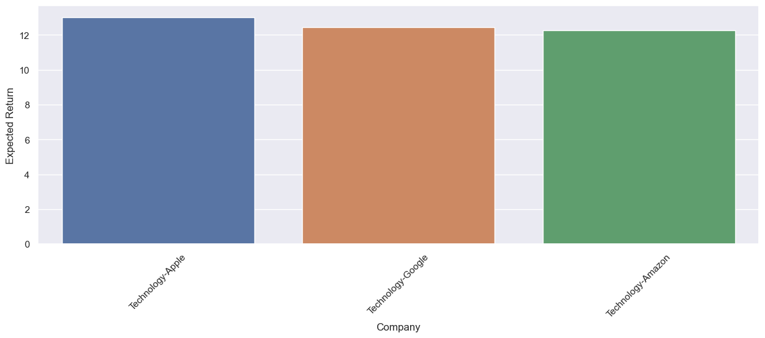
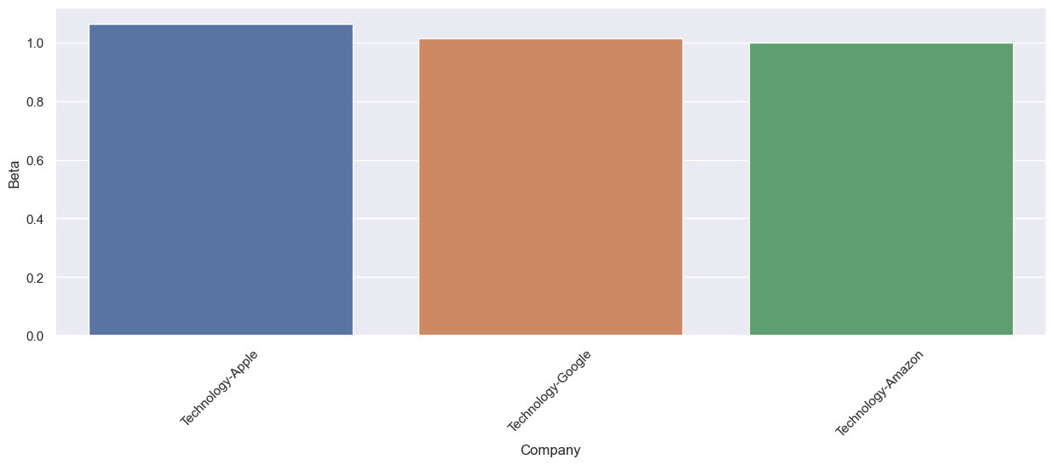
Recommended stocks – Volatility and Expected Return
Comparing Index-SP500 to beta and expected return graph Amazon Apple and Google are not much alarming and are almost on with the index SP500.
All the tech stocks give an expected return which is more than or equal to that of Index SP500
As the tech stocks show a balanced volatility and expected returns and hence can be selected for the portfolio.
Stocks | Beta | Expected Return
Index-SP500 | 1 | 12.3

Slide 13
Technology stocks like Apple, Amazon, and Google show strong positive trends, outperforming other sectors.
Aviation stocks, especially Alaska, faced a steep fall post-Covid but are recovering slowly.
Health care stocks like J&J and Merck are stable, while Bausch struggles due to past issues.
Finance stocks like Credit Suisse and Deutsche Bank have negative trends and are risky for investment portfolios.
INSIGHTS

Slide 14
RECOMMENDATIONS
Consider investing in Apple, Amazon and Google for their phenomenal growth and high returns compared to other stocks.
Include Apple, Amazon, Google, Goldman Sachs, J&J, Merck & Co, and Alaska Airlines in the portfolio due to their strong positive correlation and positive trends.
Prioritize technology and healthcare sectors as they show steady growth and recovery post-Covid.
Avoid stocks with negative correlation to the index (S&P 500) such as Bausch Health, Credit Suisse, and Deutsche Bank due to their risky nature.
Stay cautious of Credit Suisse and Deutsche Bank due to their clear negative trends and avoid including them in the portfolio.

Slide 15
THANK YOU

